Slide 1
Municipal Court Clerks Mental Wellness
July 9, 2021

Slide 2
Officer Kimber Bustos
Peace Officer since 1996
Certified Mental Health Officer
Former Nationwide instructor for the S.H.I.F.T. Program
(Supporting Heroes in Foundational mental health and wellness Training)
2154 hours of specialized police training
Former Office of the Attorney General Captain
Supervised Forensics Unit, Human Trafficking Unit and Child Exploitation Unit
Conducted Investigations
Prepared and participated in dynamic search warrant entry
Conducted Statewide Presentations and Outreach with Gov. Abbott
Former Internet Crimes Against Children Commander
Supervised 134 Supervised 134 Texas Counties for the ICAC Task Force
National Center for Missing and Exploited Children
ICAC grant management
Liberty Hill Reserve Officer since 2015

Slide 3
Private Investigator Kimber Bustos
Private Investigator since 2015
Owner and Founder of The Perfect P.I., LLC
Criminal Cases for the Travis County Capital Area Private Defenders Service
Civil Cases
Process and Subpoena Service
Background Checks

Slide 4
Objectives
Court Room Environment Issues
Effective Communication Skills
Recognizing Burnout
Solutions
Questions, Answers and Discussions
*Persons entering the office or courtroom will be referred to as defendants for continuity

Slide 5
Objectives
To learn when to say when
you need a
BREAK!
https://youtu.be/4enK-MJ7D84

Slide 6
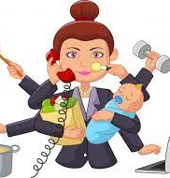
Hello Ladies!

Slide 7
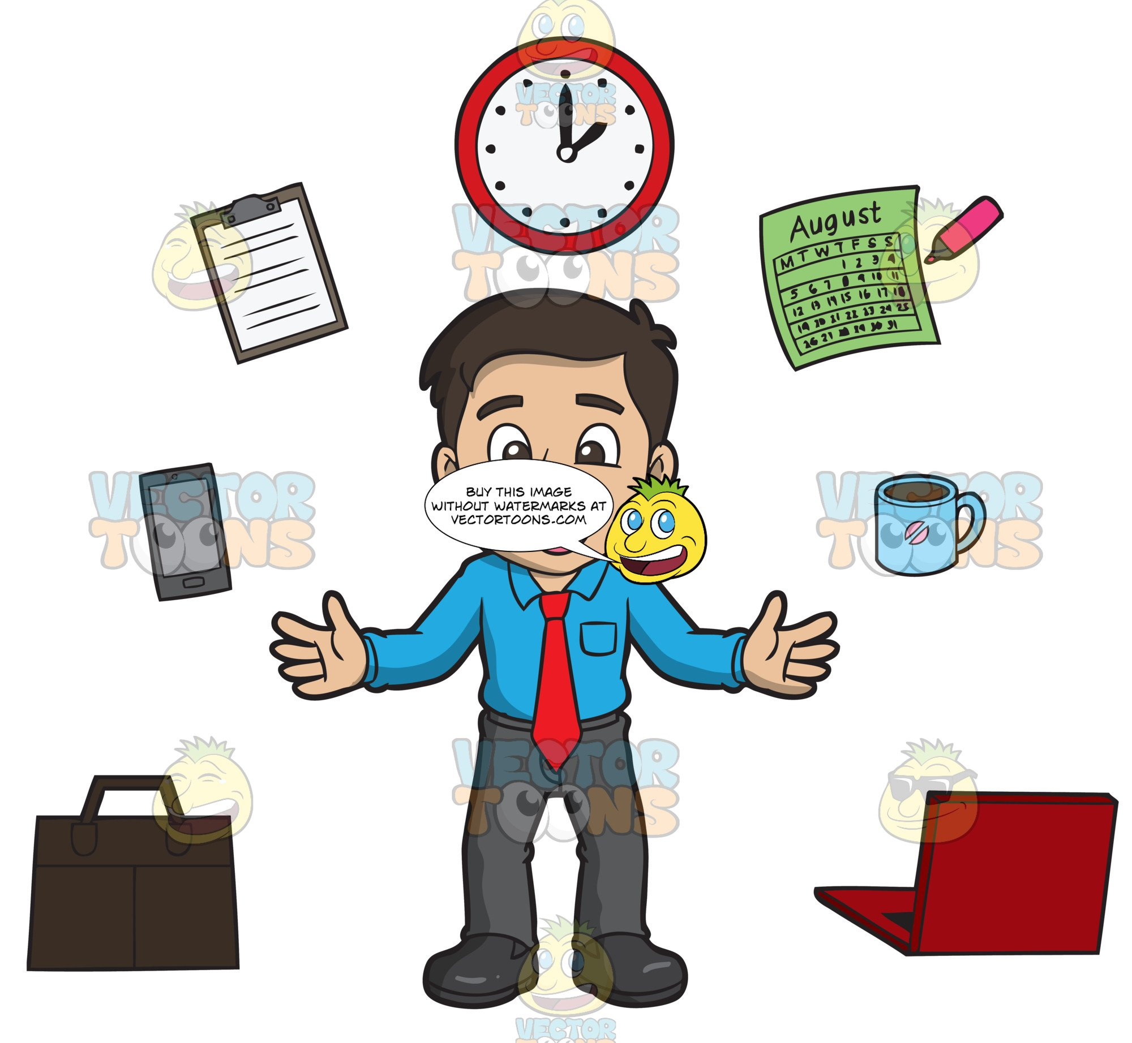
Hello Gentlemen

Slide 8
Stress & Anxiety
What is Stress
Stress results in a physical effect in the body.
Adrenaline, Cortisol, and Norepinephrine are the 3 major hormones that are released in times of stress
Causes
Not being heard
Being overwhelmed
Failure to take care of your body
People

Slide 9
Stress & Anxiety
What is Anxiety
Anxiety more of a feeling of unease, fear, or of being overwhelmed.
Thyroid Stimulating Hormones (TSH)
Adrenaline, Cortisol, Progesterone, Estrogen, Testosterone, Oxytocin and
Causes
Former trauma
Hormone imbalance
Feelings of inadequacy
Life

Slide 10
Stress & Anxiety
Types of Stress
Covid-19 stress may be Chronic or Acute
Chronic (Toxic) stress
Long lasting and damaging and can lead to lifelong physical and mental issues
Changes the way the brain communicates with the rest of the body
Results from emotional abuse/neglect, bullying, or addiction.

Slide 11
Stress & Anxiety
Types of Stress
Acute (panic attack)
Short term
Temporary thought changes
Results from sudden incidents and experiences

Slide 12
Stress & Anxiety Good Stress!
Eustress
Very Common and necessary
Results short-lived changes in stress hormone levels in the body
Teaches the body how to respond in a healthy way
Long-term exposure can lead to issues

Slide 13
“Good” Stress
Motivation
Determination
Sense of pride and accomplishment
Life goals
Forward movement

Slide 14
“Bad” Stress
Loss of sense of belonging
Loss of friends/relationships
Lack of desire to participate in activities
Solitude
Guilt

Slide 15
Emotional Feelings of “bad” Stress
Feelings of doom
Feeling unworthy
Self-hatred
Feeling lost

Slide 16
Warning signs
Frequent headaches, stomach aches or other symptoms of illness
Skipping school or a decline in participation and grades
Changes in eating habits-over eating or refusing to eat
Withdrawal from friends, family and activities
Anxiety associated with social media or text alerts and subsequent anger, depression, and/or frustration after checking their phone or computer messages

Slide 17
Warning Signs
Difficulty sleeping, sleeping too much, frequent nightmares and fatigue
Self-destructive behaviors-cutting, drug or alcohol abuse, running away from home
Disrespectful behaviors such as talking back, breaking the rules and destruction of property.
Suicide ideation or attempts

Slide 18
Warning Signs
Increased breathing/hyperventilation
Pains in the chest or other parts of the body
High blood-pressure
Loss of libido
isrespectful behaviors such as talking back, breaking the rules and destruction of property.
Suicide ideation or attempts

Slide 19
Potential causes of stress

Slide 20
Work Environment Issues
Disagreements with supervisors/co-workers
Faulty equipment
Lack of equipment
Scheduling issues
Personnel issues
Feeling trapped in your position
Doing the job of more than one person
Politics

Slide 21
Work Environment Issues
Feelings of enviousness or jealousy
Favoritism
Lack of empathy
Decisions made without input
Re-invention of the wheel

Slide 22
Home Environment Issues
Death of a friend or loved one
Parenting issues
Illness
Divorce
Lack of empathy/support
Housework/chores
Selling/buying a house
Money

Slide 23
Court Room Environment Issues
Adjustment to virtual sessions
Computer connection issues
Internet issues
Software
Social Media is often perceived as the center of social activity and interaction for today’s youth and much of society
In-Person Court Room setting
Face to Face Confrontations
Personal Safety Concerns
Interruptions
Tense environment
Administrative Stress
Responsibility for ensuring records are properly kept
Educating other Co-Workers/Supervisors
Unexpected administrative changes in procedure, personnel or record keeping
Classroom Continuing Education Hours

Slide 24
Managing Municipal Duties
Court Dates
Trials
Multitasking required
Person at the counter, telephone ringing, E-mail pinging
Data input and note taking
Co-worker and Management requests or instructions
Organization Skills are crucial
Develop a strategy
If it works, be consistent
If it doesn’t, try something new
Cross-Train if possible

Slide 25
Communication within the Court
Attitude
Defendant attitude can be hostile, angry and confrontational
Maintaining your attitude is key
Allow the Defendant to vent and don’t take it personally
Don’t try to talk over them
Do not raise your voice until necessary (sometimes it is necessary)
Maintain a respectful tone even if the defendant is being rude
Extreme verbal abuse is not ok-you have the right to walk away and contact a supervisor

Slide 26
Communication within the Court
Knowledge
Exhibit a knowledge of the process and rules
Being uninformed and unable to answer questions leads to a lack of confidence from the Defendant
Maintain contact with other Court Clerks for support and helpful tips
Expectations of Defendants
Be prepared to explain process or rules of the court more than once. It may seem simple to you, but to a person that is unfamiliar with Court, it can be overwhelming and difficult
Be prepared for Defendants to:
Disregard or forget instructions
Appear earlier than their designated time and then become frustrated
Not have the proper documents
Have outbursts
Re-appear several times

Slide 27
Communication with co-workers
Be calm
Your posture, stance and face can determine success or failure
Breath
Active listening
Don’t interupt
Do not raise your voice
Maintain respect for yourself
Extreme verbal abuse and insults are not ok-you have the right to walk away

Slide 28
Communication with co-workers
Knowledge
Think about what you want to say before-hand
Talk about it with a trusted person
Reserve you reaction for the right time and place
Be professional
Agree to disagree
Expectations of Co-workers
You deserve respect-but you must respect too
Discuss the issues but, provide suggestions/solutions
People tend to lash out when feeling inferior or sub-par

Slide 29
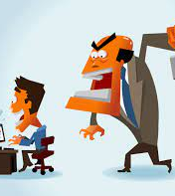
NO NO.

Slide 30
Communication at home
Patience
Stop to consider the other person’s present state
Think before you speak
No button pushing
No name calling
Take a break if need be
Sleep on it because sometimes you are going to bed angry

Slide 31
Communication at home
Active listening
It must show on your face
Shutting down leads to hostile and hurt feelings
Write it down and re-read it
Identify the facts
Suggest and be open to resolutions
Consider counseling

Slide 32
Managing Your STreSs
Give yourself a break
Journal
Get away
Remember your strengths
Sleep without guilt
One thing at a time
Try Something new
Do something special for someone else
Dark Chocolate

Slide 33
Tell your story
Color or draw
Laugh
Turn off your phone
Take a nap
Breathe deep
Take a bath
Intimacy

Slide 34
Cuddle an animal
Go see a sight in your city you haven’t seen before
Pack a healthy lunch or snacks instead of eating fast food
Let past hurts go
Smile
Thank someone
Compliment someone
Drink something tasty

Slide 35
Watch a baby laugh
https://www.youtube.com/watch?v=L49VXZwfup8
Watch bloopers
Watch funny fails

