Slide 1
HARMONY in the Workplace
Pat Riffel, CMCC, CPM

Slide 4
WHAT DO THOSE WORDS MEAN TO YOU!

Slide 6
Common cause of workplace conflict
Changes in management
Changes in staff
Change in procedure
Change in duties or position descriptions
Redundancies
Personality clashes

Slide 8
Contributing factors in conflict:
Lack of communication; whether between co-workers or management/coworkers
A failure to share a vision
Mistrust or suspicion
Insufficient leadership or micromanagement
“Territorialism” jealousy

Slide 9
Six practical ways to make your workplace more harmonious
Talk to and engage everyone in a positive manner, always.
Ensure everyone does his/her own workload
Advocate—daily-for unity and respect
Make work fun and productive
Praise and recognize employees on all levels, often.
Untie the Knots ® of Conflict

Slide 10
HOW TO “Untie the Knots of Conflict” Ty Howard
This Photo by Unknown Author is licensed under CC BY-SA
This Photo by Unknown Author is licensed under CC BY

Slide 11
Calm down/Cool off period
Set the stage
Tell what's bothering you using “I” statements
Define the problem and take responsibility
Brainstorm solutions
Negotiate to one solution and create agreement
Affirm, forgive, thank
Put agreement into place
Schedule a follow up

Slide 13
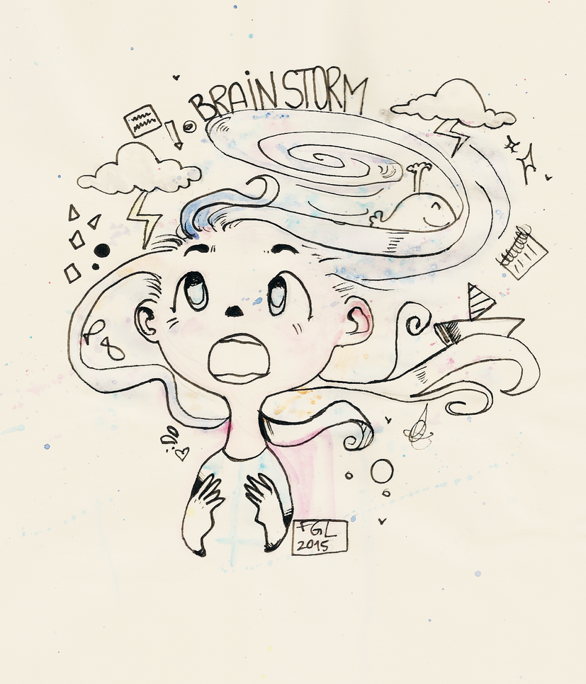
Tell me about the worst leader you ever had!

Slide 14
AND NOW… THE BEST!!!

Slide 15
Leaders Guide to Improving Employee Morale
One on one sessions
Create Healthy work environment
Acknowledge and appreciate employees
Be personable
Motivate your employees
Empower your employees
Involve employees are equal members of the team
Show care to your employees

Slide 16
SHARING IDEAS
“Camp Fire”
“The Good, the Bad and the Ugly”
Wonderwoman
Toy soldiers
Flowers
Stickers

Slide 19
PERFECT HARMONY

